Slide 1



NASA Robotics Mining Competition
Ben Stinnett, ASU
Dr. Srikanth Saripalli, ASU
Tucson, AZ
April 12, 2014

Slide 2

Overview:
NASA Robotics Mining Competition
Previous participation
2014 goals and objectives
Conclusions

Slide 3
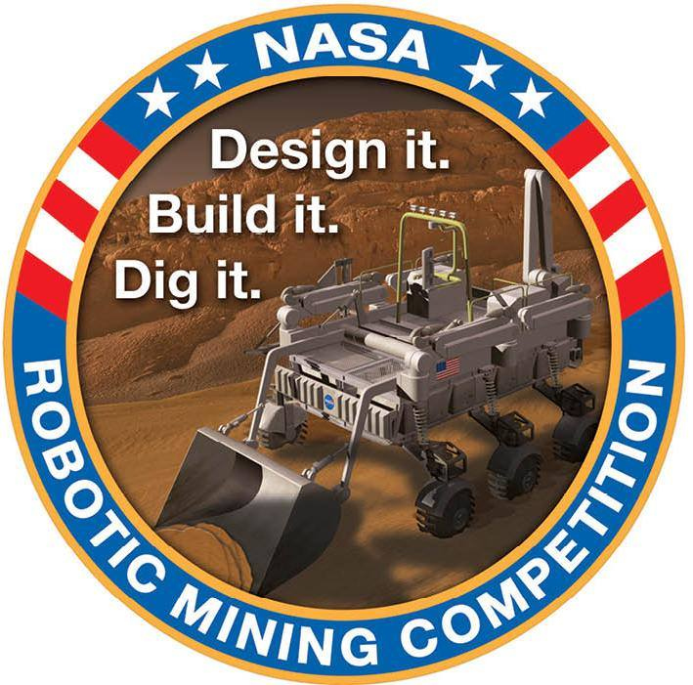
NASA Robotics Mining Competition
Build a telerobotic or autonomous excavator
Mine and deposit at least 10kg of regolith simulant in 10 minutes
Maintain size and weight constraints
Complete a variety of systems engineering and STEM outreach tasks

Slide 4
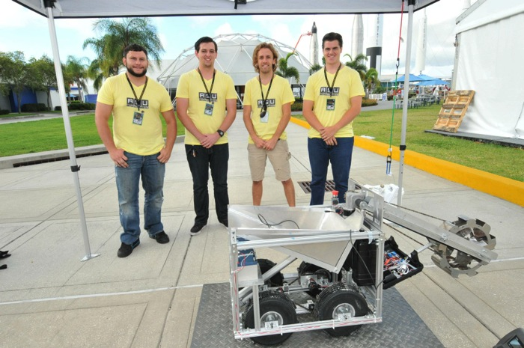
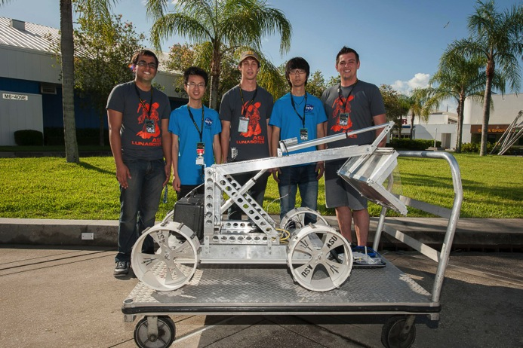
Previous Years – 2012 and 2013
Learning by doing:
2012
2013

Slide 5
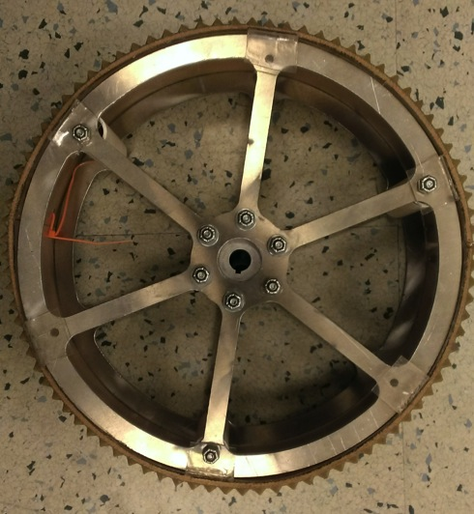
2014 Goals and Objectives
Lightweight- make every kilogram count
-Develop and fabricate the robot using robust yet lightweight materials
Key Focus Areas:
-Wheels
-Frame
-Collection mechanism

Slide 6
2014 Goals and Objectives
Collection Efficiency
-Design and fabricate a collection mechanism to collect the regolith as efficiently as possible
Key Focus Areas:
-Minimize trips between mining area and collection bin
-Scooping efficiency
-Dust mitigation

Slide 7
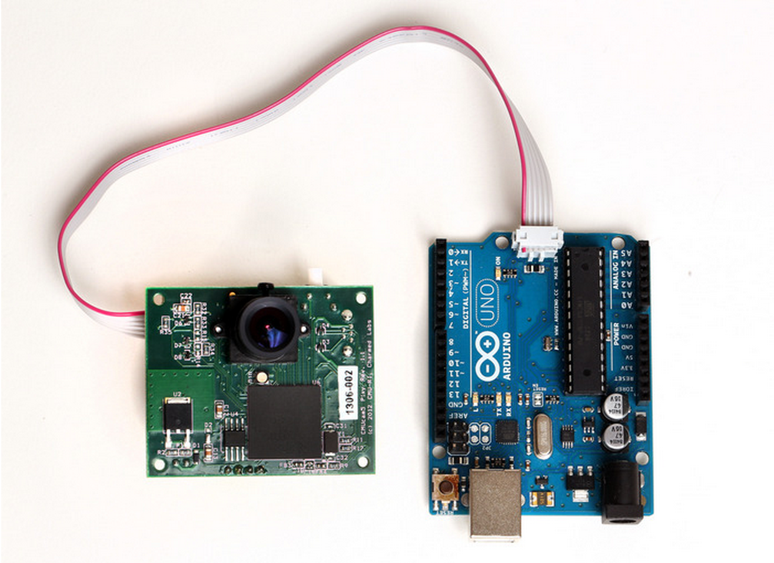
2014 Goals and Objectives
A Fully Autonomous Vehicle
-Develop a robust control system to enable fully autonomous operations.
Key Focus Areas:
-Sensor Integration
-Closed loop operations
-Teleoperation redundancy.

Slide 8

Conclusions
After a 9th place finish in 2013, the team has learned a lot and improved on the shortcomings.
By saving weight, increasing collection efficiency, and attempting full autonomy, the team is capable of finishing in the top 3.
With 38 days left before the competition, the team is currently performing final tests and preparing to ship the robot.

Slide 9
Thank you!
This project would not be possible without the invaluable mentoring from Dr. Srikanth Saripalli, as well as the support of Arizona NASA Space Grant and the School of Earth and Space Exploration.

